Slide 1
Right to Education &
Early Childhood Education and Development;
Foundation for Quality Learning –
Evidence from South Asia
Presentation:
“Teacher Preparation in ECE in Sindh Province”
Qamar Shahid Siddiqui
Director General
PITE Sindh

Slide 2
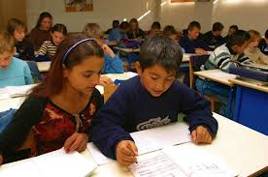
Article 25-A
[25A. Right to education.---The State shall provide free and compulsory education to all children of the age of five to sixteen years in such manner as may be determined by law.]

Slide 3
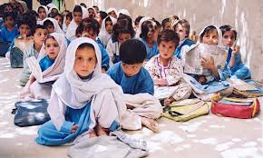
The Sindh Right of Children to Free and
Compulsory Education Act, 2013
3. (1) Every child of the age of five to sixteen years regardless to sex and race shall have a fundamental right to free and compulsory education in a school.
p.2

Slide 4
NEP 2009 on ECE
NEP2009 on ECE says:
‘ECE age group shall be recognized as comprising 3 to 5 years’.
“ Historically, however, ECE has not been formally recognized by the public sector in Pakistan. The traditional ‘katchi’ class in some public sector schools has predominantly remained a familiarization stage towards formal schooling for un-admitted, young students. A limited part of the Grade I National Curriculum is taught to this group”.
p.35

Slide 5
Sindh Education Sector Plan
(2014-18)
SESP (Chapter on ECE) says:
To date, however, the Government of Pakistan has not made concerted efforts to increase access to Early Childhood Education and Development, or towards improving the quality of ECE. The province of Sindh, has not systematically built upon earlier efforts to promote Early Childhood Education (ECE).
p-82

Slide 6
SESP on TED/Deployment
SESP (ECE Chapter) says:
One of the key issues for ECE in Sindh province is that there is no teacher development and/or deployment strategy, nor an ECE-specific cadre of teachers.
p.87

Slide 7
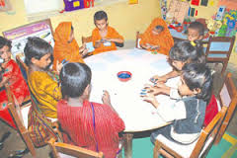
NEP 2009 on ECE quality
‘Improvements in quality of ECE shall be based on a concept of holistic development of the child that provides a stimulating, interactive environment, including play, rather than a focus on regimes that require rote learning and rigid achievement standards.’ (NEP 2009, p. 35)

Slide 8
NEP 2009
Teachers’ quality – Present state of affairs
There is a consensus amongst all stakeholders that the quality of teachers in the public sector is unsatisfactory. Poor quality of teacher in the system in large numbers is owed to the mutations in governance, an obsolete pre-service training structure and a less than adequate in service training regime. Presence of incompetence in such a huge quantity and permeation of malpractices in the profession have eroded the once exalted position enjoyed by teachers under the eastern cultural milieu. Teaching has become the employment of last resort of most educated young persons; especially males.

Slide 9
SESP on TED
SESP (Chapter 9 on TED) says:
‘Teacher Education and Development (TED) is a critical factor in improving school effectiveness and student learning outcomes’.
p.176

Slide 10
ECE Teachers Preparation in Sindh province – opportunities
ELD committed for ECE, created 8000 ECE teachers vacancies.
SESP (2014-18) with focus on ECE has been approved
ECE Curriculum is available.
ECE Teacher Guides (Developed by PITE in Sindhi and Urdu versions with the support of TRC and UNESCO)
NPSTP 2009 is available
PITE, GECEs, TRCs are functional.

Slide 11
ECE Teacher Prep.
PERs
Curriculum
Training
Teacher
Performance Management
Record Maintenance
ECE Teacher
Training Manual
Support
Training Delivery
Performance Monitoring
QA

Slide 12
ECE Teacher Preparation – Recommendations
Recruitment rules for ECE teachers with diploma in ECE should be mandatory qualification.
Recruitment on the basis of merit.
Induction Training of ECE Teachers in local language and using ECE Curriculum.
Provide all requisite facilities in TTIs
Quality Assurance of ECE Training by STEDA
Teacher Performance Management by DEO.
CPD on cyclic basis (after every three years).

